Slide 1
The Impact of the Data Revolution on Official Statistics: Opportunities, Challenges and Risks
Prof. Rob Kitchin
Maynooth University

Slide 2
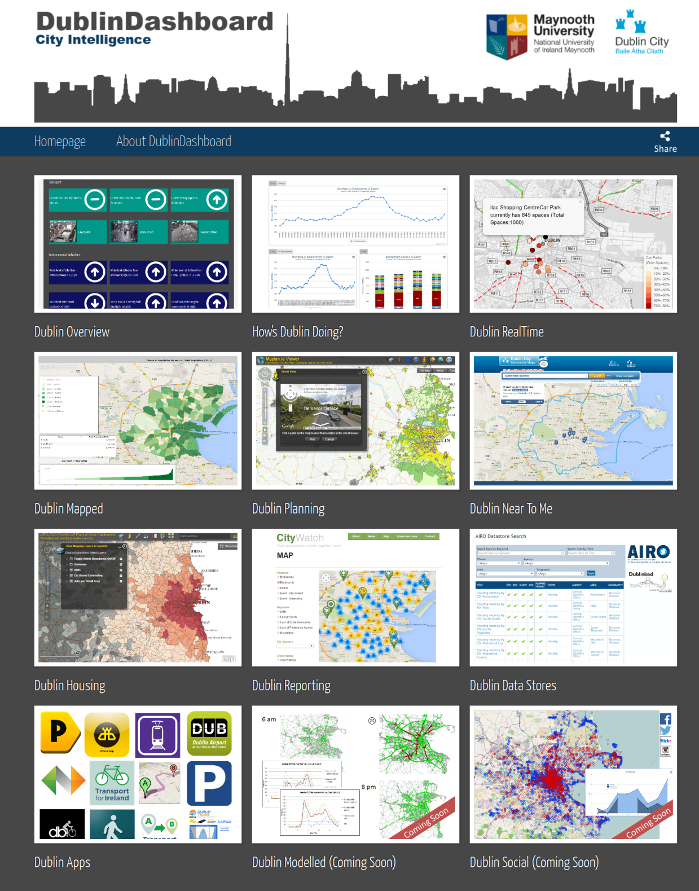
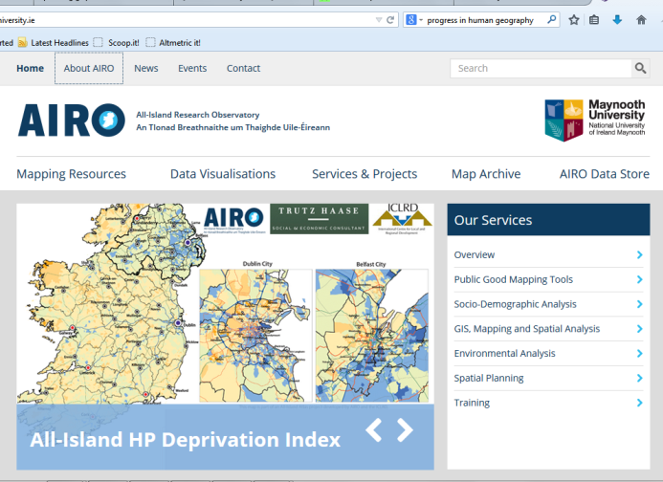
Background
All-Island Research Observatory (www.airo.ie)
Dublin Dashboard (www.dublindashboard.ie)
Digital Repository of Ireland (DRI; www.dri.ie)
The Programmable City

Slide 3
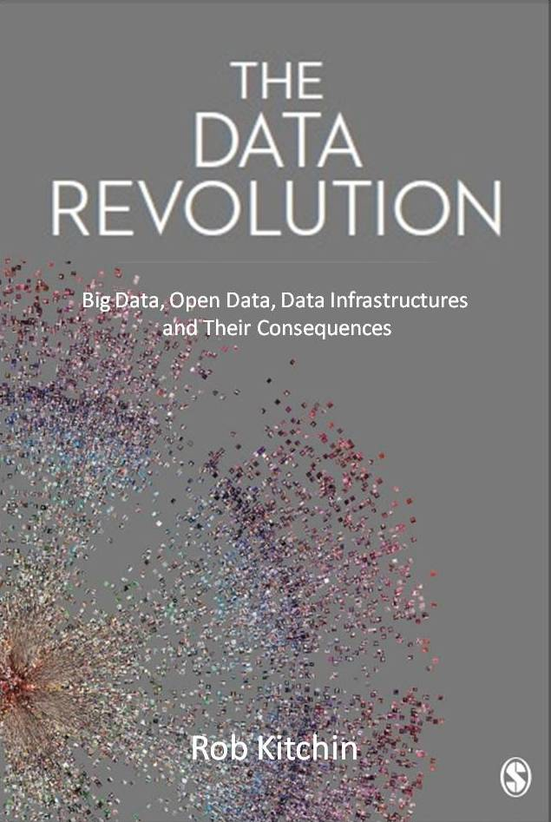
The data revolution
Data infrastructures
Open and linked data
Big data
Data analytics
Data markets
Data ethics
Conceptualisation of data
Create disruptive innovations that offer opportunities, challenges and risks for government, business and academy

Slide 4
Data infrastructures
Actively planned, curated and managed
Enables storing, scaling, combining, sharing and consuming data across networked archives and repositories
NSIs long operated as such trusted data infrastructures
Now a need to organise into more coordinated platforms -– National Data Infrastructures, with:
dedicated and integrated hardware and networked technologies; interoperable software and middleware services and tools; shared standards, protocols, metadata; shared services, analysis tools & policies
Also skilled staffing operating across govt departments/agencies – Irish Government Statistical Service
Data within NDIs being federated into larger pan-national infrastructures (Eurostat, ESPON, UN, etc)

Slide 5
Open and linked data
Opening PSI (and other) data for re-use
Driven by arguments re. transparency, participation, collaboration, economic development
Linking data/metadata using non-propriety formats and URIs and RDF
NSIs already very active in this space; other government data providers much further beyond
More to be done, especially:
retro opening and linking of historical records
producing APIs & machine-readable formats
upgrading extent of openness (licensing re. re-use, reworking, redistribution, reselling)
using non-proprietary formats
opening data about the organizations themselves

Slide 6
Big data
Characteristic | Small data | Big data
Volume | Limited to large | Very large
Exhaustivity | Samples | Entire populations
Resolution and indexicality | Coarse & weak to tight & strong | Tight & strong
Relationality | Weak to strong | Strong
Velocity | Slow, freeze-framed | Fast
Variety | Limited to wide | Wide
Flexible and scalable | Low to middling | High

Slide 7
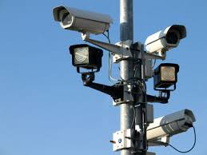
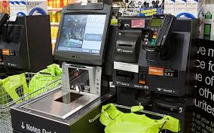
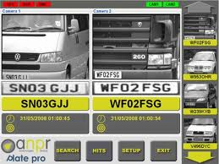
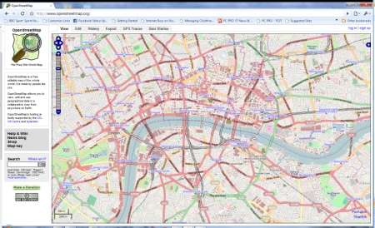
Big data
Diverse range of public and private generation of fine-scale data about citizens and places in real-time:
utilities
transport providers
environmental agencies
mobile phone operators
travel and accommodation websites
social media sites
financial institutions and retail chains
private surveillance and security firms
emergency services

Slide 8
Data analytics
Challenge of making sense of big data is coping with its:
abundance and exhaustivity
timeliness and dynamism
messiness and uncertainty
semi-structured or unstructured nature
Solution has been machine learning made possible by advances in computation
Four broad classes of analytics:
data mining and pattern recognition
statistical analysis
prediction, simulation, and optimization
data visualization and visual analytics

Slide 10
Big data and official statistics (source ESSC 2014)
Data source | Data type | Statistical domains
Mobile communication | Mobile phone data | Tourism statistics Population statistics
WWW | Web searches | Labour statistics Migration statistics
 | e-commerce websites | Price statistics
 | Businesses’ websites | Information society statistics Business registers
 | Job advertisements | Employment statistics
 | Real-estate websites | Price statistics (real estate)
 | Social media | Consumer confidence; GDP and beyond; information society statistics
Sensors | Traffic loops | Traffic/transport statistics
 | Smart meters | Energy statistics
 | Satellite images | Land use statistics; agricultural statistics; environment statistics
 | Automatic vessel identification | Transport and emissions statistics
Transactions of process generated data | Flight movements | Transport and emissions statistics
 | Supermarket scanner and sales data | Price statistics Household consumption statistics
Crowdsourcing | Volunteered geographic information (VGI) websites (OpenStreetMap, Wikimapia, Geowiki) | Land use
 | Community pictures collections (flickr, Instagram, Panoramio) | -

Slide 11
Big data and official statistics
Given its scope, timeliness, and resolution big data have captured the interest of:
NSIs
Eurostat, the European Statistical System (ESS)
United Nations Economic Commission for Europe (UNECE)
United Nations Statistical Division (UNSD)
In 2013 EU NSIs signed the Scheveningen Memorandum to examine the use of big data in official statistics
Initial analysis indicates that whilst big data offer a number of opportunities for official statistics, they also offer a series of challenges and risks

Slide 12
Big data: opportunities
Complement, replace, improve, and add to existing datasets/statistics
Produce more timely outputs - nowcasting
Compensate for survey fatigue of citizens and companies
Complement and extend micro-level and small area analysis
Improve quality and ground truthing
Refine existing statistical composition
Easier cross-jurisdictional comparisons
Better linking to other datasets
New data analytics producing new and better insights
Reduced costs
Optimization of working practices and efficiency gains in production
Redeployment of staff to higher value tasks
Greater collaboration with computational social science, data science, and data industries
Greater visibility and use of official statistics

Slide 13
Big data: challenges
Forming strategic alliances with big data producers
Gaining access to data, procurement and licensing
Gaining access to associated methodology and metadata
Establishing provenance and lineage of datasets
Legal and regulatory issues, including intellectual property
Establishing suitability for purpose
Establishing dataset quality with respect to veracity (accuracy, fidelity), uncertainty, error, bias, reliability, and calibration
Technological feasibility re. transferring, storing, cleaning, checking, and linking big data
Methodological feasibility re. augmenting/producing OSs
Experimenting and trialing big data analytics
Institutional change management and staff re-skilling
Ensuring inter-jurisdictional collaboration and common standards

Slide 14
Big data: risks
Mission drift
Data quality and losing control of generation / sampling / processing
Inconsistent access and continuity (breaks in method/time-series)
Privacy breaches and data security
Damage to reputation and losing public trust
Resistance of big data providers and populace
Fragmentation of approaches across jurisdictions
Resource constraints and cut-backs
Privatisation and competition

Slide 15
Way forward
UNECE Big data sandbox
Hosted by Central Statistics office (CSO) and the Irish Centre for High-End Computing (ICHEC)
Technical platform to:
test the feasibility of remote access and processing
test whether existing statistical standards / models / methods etc. can be applied to Big Data
determine which Big Data software tools are most useful for statistical organisations
learn more about the potential uses, advantages and disadvantages of Big Data sets – “learning by doing”
build an international collaboration community to share ideas and experiences on the technical aspects of using Big Data

Slide 16
Way forward
Need to find common international positions on:
conceptual and operational (management, technology, methodology) approach and dealing with risks;
other roles NSIs might adopt, such as becoming the arbiters or certifiers of big data quality, or becoming clearing houses for statistics from non-traditional sources
resolving issues of access, procurement, licensing, and standards
identifying and tackling privacy, ethics, security, legal, and governance issues
establishing best practices for change management that will maintain quality standards, continuity and trust
resourcing at national and international scales

Slide 17
Conclusion
A data revolution is underway
a fundamental shift in data openness and sharing
the scaling into data infrastructures
big data and new data analytics
Creating a set of disruptive innovations that are producing opportunities, challenges and risks for NSIs and statistical systems
It is important for NSIs to get ahead of the curve with respect to challenges and risks, becoming proactive not reactive and setting the agenda for new data and statistical innovations
This requires conceptual, practical, technical and strategic thought and a coordinated approach

Slide 18
Conclusion
NSB’s Strategic Priorities for Official Statistics 2015-2020 sets a framework and roadmap for Ireland
Some elements of the Irish Statistical System are already worldclass and at the cutting edge -- CSO, OSI -- in other areas we lag behind
The NSB’s Priorities provides a holistic approach for consolidating and extending excellence and aiding the rest of the system to catch up
The suggestions re. NDI and IGSS will be especially valuable if implemented
Will require reform of data culture, practices, governance and sharing in public sector: which is long overdue

Slide 19
Rob.Kitchin@nuim.ie
@robkitchin
http://www.nuim.ie/progcity
@progcity
Kitchin, R. (2015) The opportunities, challenges and risks of big data for official statistics. Statistical Journal of the International Association of Official Statistics 31(3): 471-481.
Kitchin, R., Lauriault, T. and McArdle, G. (2015) Knowing and governing cities through urban indicators, city benchmarking and real-time dashboards. Regional Studies, Regional Science 2: 1-28
Kitchin, R. and Lauriault, T. (2015) Small data in the era of big data. GeoJournal 80(4): 463-475
Kitchin, R. (2014) Big data, new epistemologies and paradigm shifts. Big Data and Society 1 (April-June): 1-12.

