Slide 1
Data as a public good: opportunities & challenges
Muiris O’Connor
Department of Health
NSB Seminar
Dublin Castle
25th October 2016

Slide 2
“Health”

Slide 3
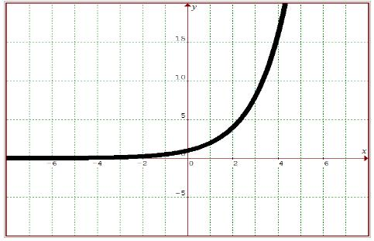
My First impressions:
everything in health is presented as Exponential…

Slide 4

“lots of data, little information
less intelligence”
(Dr. Howard Johnson)
Deciphering signal from the noise

Slide 5
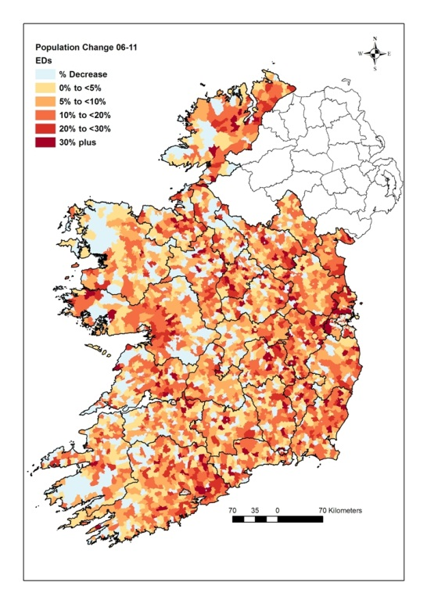
The grid

Slide 6

The focus

Slide 7

The imperative

Slide 8
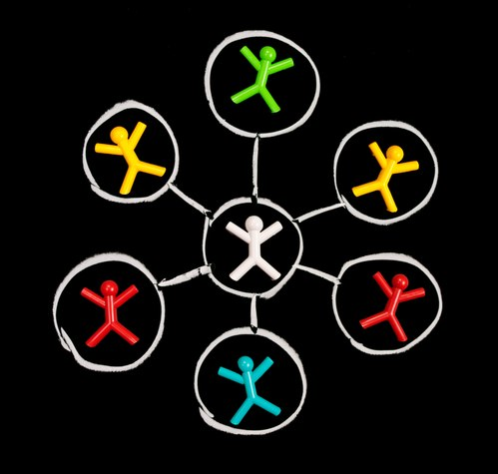
…addressing fragmentation…

Slide 9

…building…

Slide 10
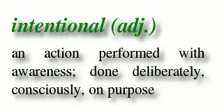
Intentionality

Slide 11

...towards a national approach

Slide 12
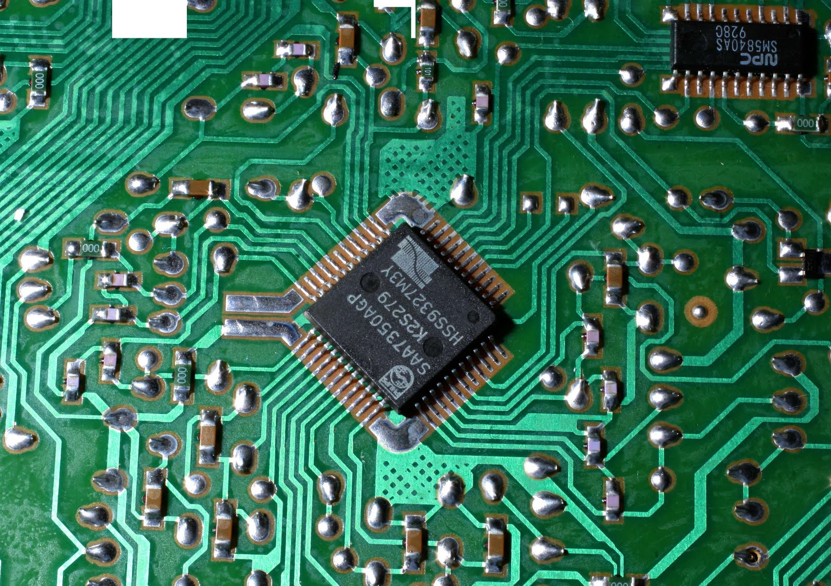
Data as an enabler of…
…health services improvement

Slide 13
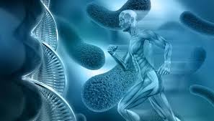
Data as an enabler of…
…advances in medical science

Slide 14

Data as an enabler of…
…population health and wellbeing

Slide 15
Back to the grid…
& the national statistical infrastructure

Slide 16
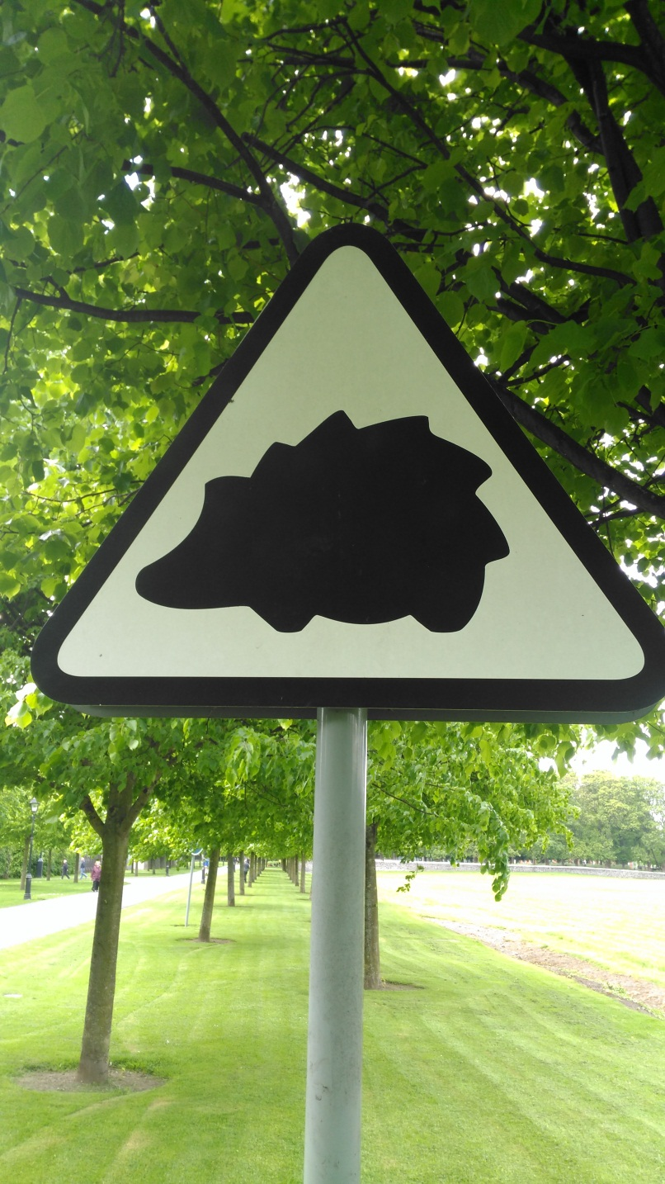
Enabling data…

Slide 17

Go raibh maith agaibh!
Muiris_OConnor@health.gov.ie

